Slide 1
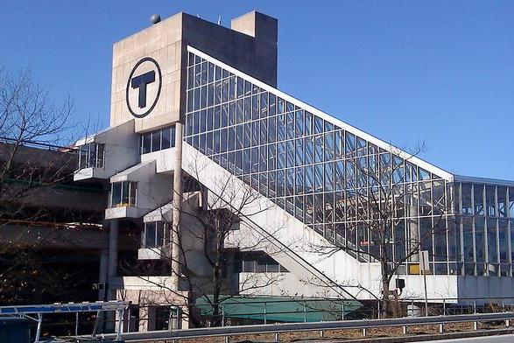
CASE STUDY: ALEWIFE MBTA STATION GARAGE
December 13, 2021
ENMA 664 - Final Term Presentation
Amanda P. Siciliano
Image of Alewife Station Complex [1]

Slide 2
INTRODUCTION
01
PROBLEM STATEMENT
02
CORROSION EXPLANATION
03
TABLE OF CONTENTS
PREVENTION METHODS
04
CONCLUSION
05
About the Alewife Station project
Explanation of ongoing issues
Details about causes, detection testing methods, and corrosion mechanisms
Rehabilitation techniques for extending useful life of structure
Summary of project and question/answer section

Slide 3
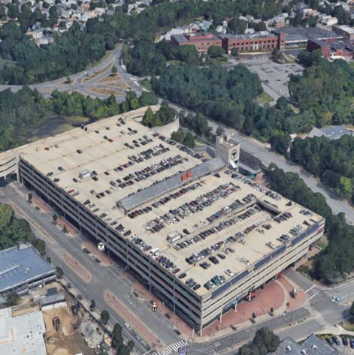
INTRODUCTION
MBTA Alewife Station Complex
Located in Cambridge, MA
Built in 1980
5 parking levels
Structural and drainage deficiencies from corrosion
Image of Alewife Station Complex from Google Maps [2]

Slide 4
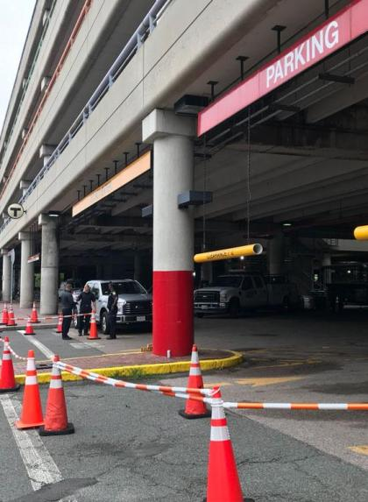
PROBLEM STATEMENT
Severe economic loss
$20 million+ rehabilitation projects
3% GDP = corrosion projects
D+ infrastructure rating
Unsafe conditions
Delaminated concrete falling on cars
Immediate life safety concerns
Structural & drainage system deficiencies
Image of construction at Alewife Station Complex [3]

Slide 5
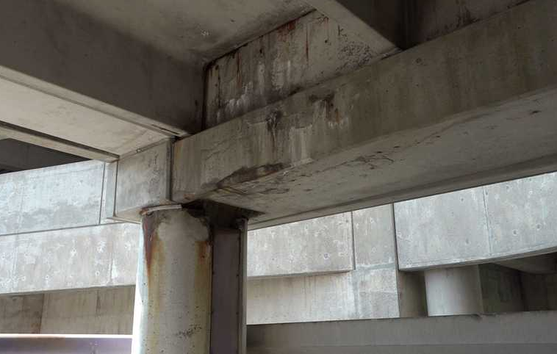
CORROSION EXPLANATION
WATER INFILTRATION
COLD CLIMATE
BIRD NESTING
Broken & clogged drainage pipes causing concrete spalling & cracking
Northeastern location (85 - 15 F) often using deicing salts during winter
Pigeons nesting along precast girders causing bird droppings on concrete
Image of girder at Alewife Station Complex [4]

Slide 6
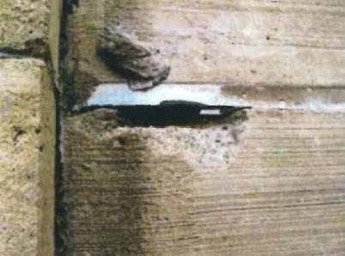
SEALANT & SPALLING FAILURES
CORROSION EXPLANATION
WATER INFILTRATION
BEAM CRACKS & JOINTS
BROKEN & CLOGGED DRAINAGE
Image of flange joint deterioration [5]
Allows water to seep through and cause deteriorations to metal decking
Allows water to leak to lower levels of garage, where extent of deterioration is larger than roof level
Partial drain blockages create water ponding and concrete spalling/cracking

Slide 7
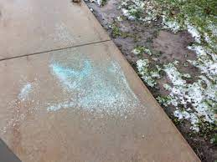
USE OF DEICING SALTS
CORROSION EXPLANATION
COLD CLIMATE
FREEZE-THAW DEGRADATION
FAILED SEALANTS & BROKEN JOINTS
Image of deicing salts [6]
Typically carried in through vehicles with high chloride ions content, which speeds up corrosion
Winter conditions can cause constant successive cycles, which causes expansion and cracking of concrete
Allows deicing chemicals to seep through and cause deteriorations to reinforcing steel and concrete decking

Slide 8
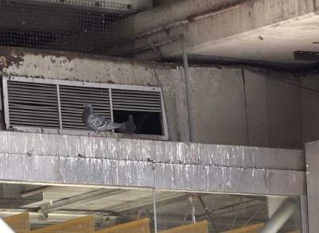
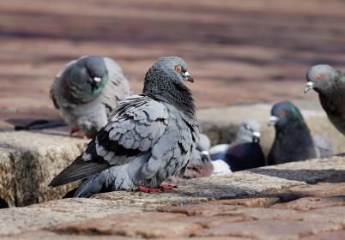
NESTING ALONG PRECAST GIRDERS
CORROSION EXPLANATION
BIRD NESTING
ACCUMULATED BIRD DROPPINGS
Image of pigeons nesting in HVAC system [4]
Nesting along garage perimeter occurs in the shelves of precast girder ledges
Acidic nature accelerates deterioration of concrete and reinforcing steel over time
Image of pigeons [7]

Slide 9
NON-
DESTRUCTIVE TESTING
DESTRUCTIVE TESTING
CORROSION EXPLANATION
DETECTION METHODS
Visual observations
Photographic documentation
Physical measurements
Hammer sounding
Partial depth concrete removal
Concrete coring & drilling
Chloride ion tests
Petrographic analysis

Slide 10
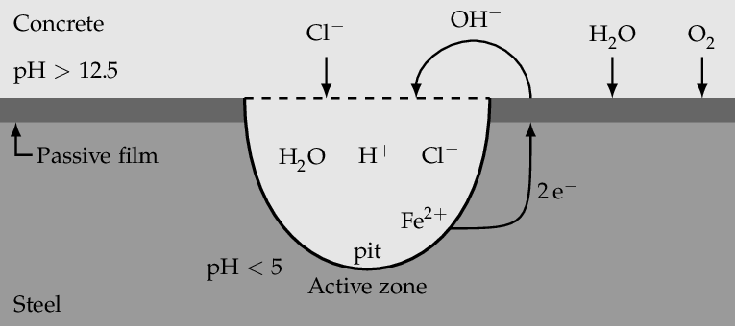
CORROSION MECHANISM
FORM OF CORROSION: Pitting
High chloride ion content (from deicing salts) attack passive film
ANODIC REACTION: Fe -> Fe2+ + 2e
CATHODIC REACTION: ½ O2 + H20 + 2e -> 2(OH)-
CORROSION-ACCELERATING REACTION: FeCl2 + 2H2O -> Fe(OH)2 + 2HCl
Dissolved chloride salts in water act as electrolyte solution
Image of pitting corrosion [8]

Slide 11
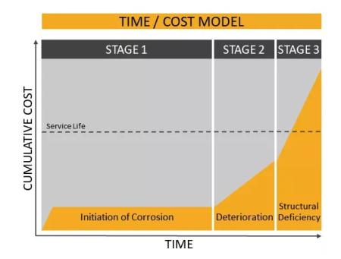
CORROSION MECHANISM
KINETICS OF STAGE 1: Linear Oxidation Rate
KINETICS OF STAGE 2: Linear Oxidation Rate
KINETICS OF STAGE 3: Logarithmic Oxidation Rate
LOGARITHMIC OXIDATION RATE EQUATION:
x = k ln (at+1)
x = oxide film thickness
k, a = constants
t = time
Image of corrosion time/cost model [9]

Slide 12
OPTION 1
OPTION 2
PREVENTION METHODS
OPTION 3
Sand, cut and clean out exposed reinforcing bar rust
Image of precast beams [10]
Apply epoxy bonding agent coating or rust inhibitor paint
Image of Sika logo [9]
Clean and fully replace joint covers to protect and prevent further deterioration
Image of expansion joint covers [11]

Slide 13
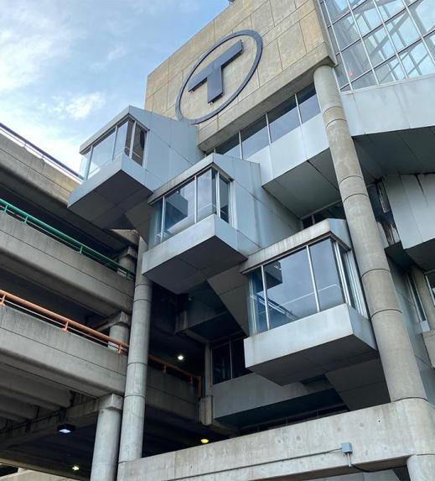
CONCLUSIONS
MBTA Alewife Garage in critical condition
Concrete and metal deterioration caused by water infiltration, cold climate and bird nesting
Pitting is most common type of corrosion
$22 million project underway to improve safety, accessibility and longevity
Image of Alewife Station Complex [3]

Slide 14
THANK YOU!
Are there any questions?
Image of Alewife Station Complex [1]

Slide 15
REFERENCES
[1] Mohl, Bruce. (2018). MBTA to try surge pricing for parking. CommonWealth.
[2] Map showing location of MBTA Alewife Station Complex. Google Earth.
[3] Levy, M. (2018). MBTA reopens Alewife T garage for weekdays after assessment, repairs of crumbling ceiling. Cambridge Day.
[4] Anderson, Karen & Wells, Jon. (2018). Advanced levels of deterioration found in massive MBTA parking garage. WCVB News.
[5] Kleinfelder/SEA Consultants. (2011). MBTA Alewife garage condition assessment report. MBTA.
[6] Alfuth, Diana. (2016). De-icing salts and landscapes don’t mix. University of WIsconsin-Madison.
[7] Bird Control Solutions. Safe Guard Pest Control. https://www.amesgroup.uk.com/blog/how-to-deter-pigeons/
[8] Hackl, Jurgen. (2013). Generic framework for stochastic modeling of reinforced concrete deterioration caused by corrosion. Norwegian University of Science and Technology.
[9] Corrosion Protection. Sika USA. https://usa.sika.com/en/construction/repair-protection/corrosion-protection.html
[10] MBTA. (2019). Ongoing Repairs. Twitter. https://twitter.com/mbta/status/1121084215100100608
[11] (2021). Expansion joint covers. Cloutman & Stingley Inc. https://www.cloutmanandstingley.com/expansion-joint-covers-1
[12] Thornton Tomasetti. (2017). Alewife parking garage assessment report - condition assessment report. MBTA.

